Slide 1

Tai-Hua Chung, Olivia Natasha, Randy Shi, Jared Sinsheimer, Dan To

Slide 2
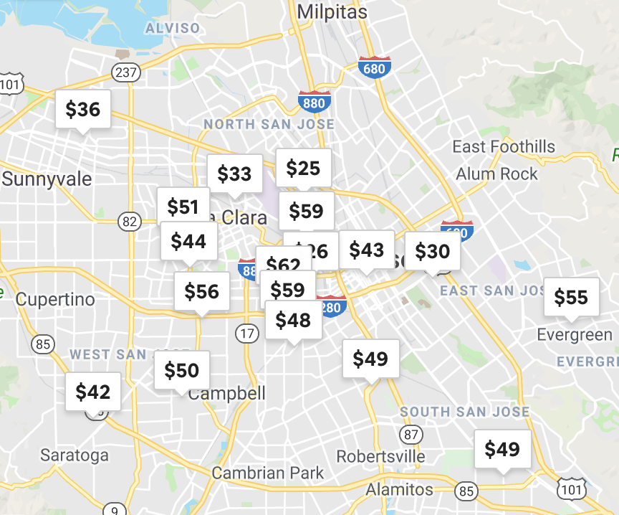
Airbnb Price Recommendation
How much should you charge?
Objective:
Provide Price Recommendation Model for new listing
Find out price factors
Benefits:
For Host:
Set competitive pricing
Increase booking potential
For Traveler:
Find reasonable pricing accommodation
For Business (see next page)

Slide 3
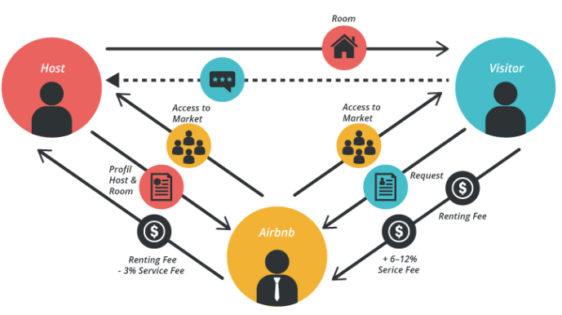
Business Importance
Airbnb Business Model
Revenue Source:
From Traveler:
6 -12% Service fee (based on trip duration)
Renting fee
From Host:
3% Booking fee
→ Incentive to optimize number of bookings and trip price
Grapht: https://bmtoolbox.net/stories/airbnb/

Slide 4
Data Summary
Overview
Statistics

Slide 5
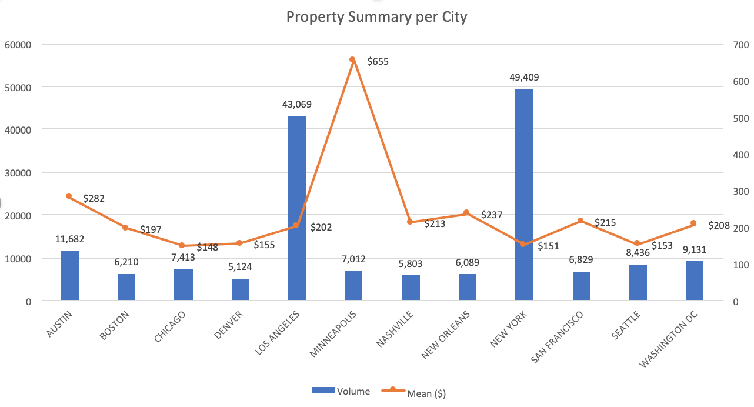
Summary Statistics Before Cleaning
Data Source: Insideairbnb.com which performs monthly webscrapes of Airbnb data
Listing information is gathered from 12 major cities across all four census regions in the United States in November 2018
Total 166,207 observations dominated by Los Angeles (25.91%) and New York (29.73%).
Overall average of $234.60/ night and median of $133.29/night

Slide 6
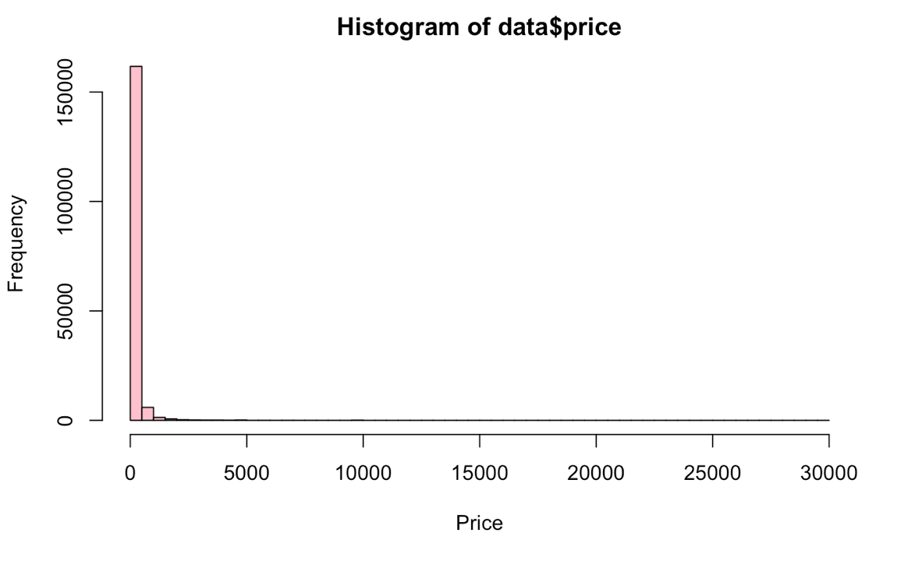
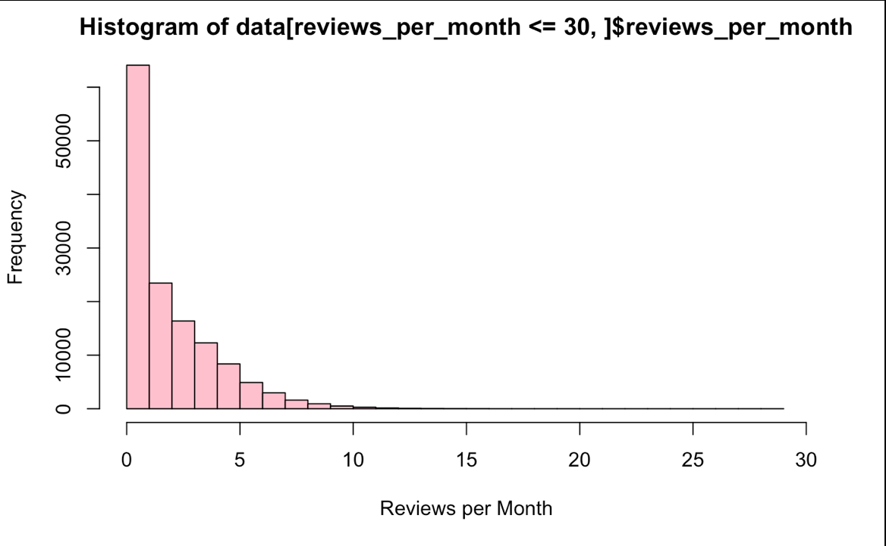
Modeling Sample Selection
Removed:
review_per_month <1 (~35%) null value (~20%)
Removed extreme pricing

Slide 7
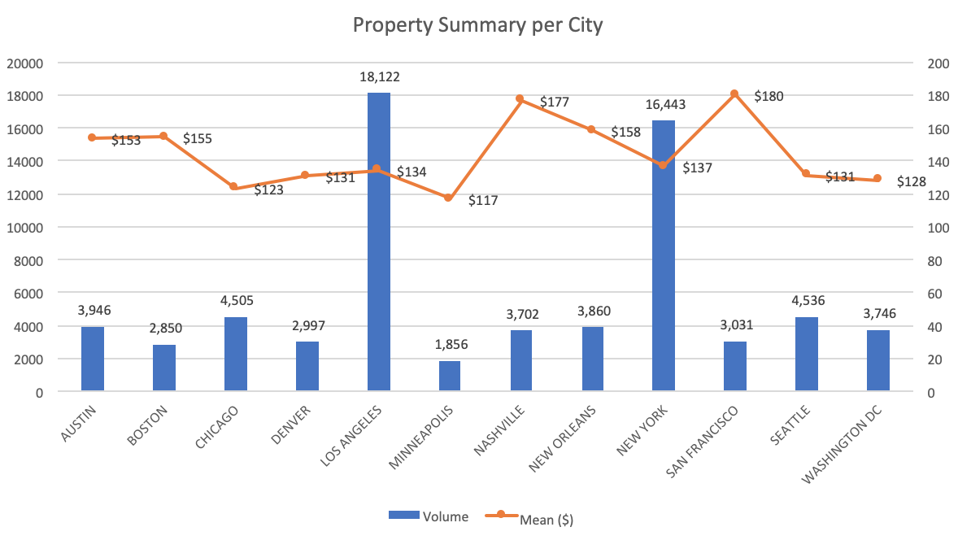
Summary Statistics After Cleaning
Removed observation that had less than 1 reviews per month
Total 69,594 cleaned observations dominated by Los Angeles (26.04%) and New York (23.63%).
Overall average of $143.67/ night and median of $108.83/night

Slide 8
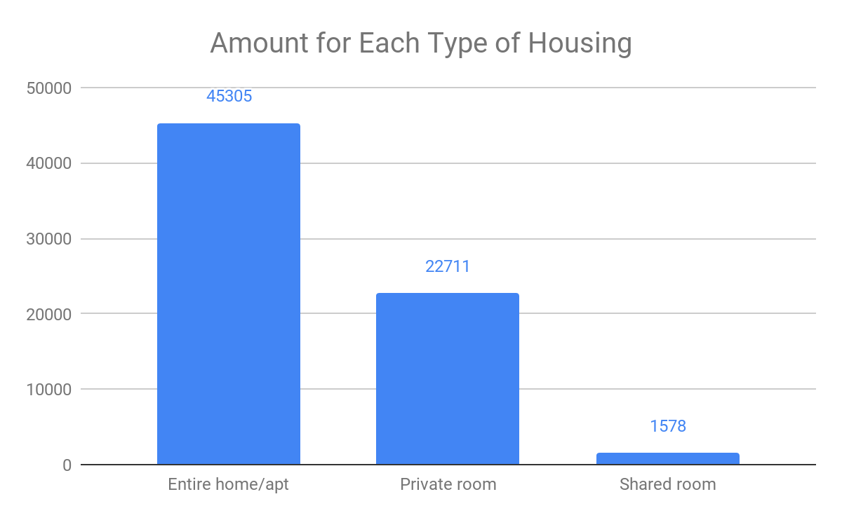
Summary Statistics
Most hosts rent out their entire home or apartment (65.1%).

Slide 9
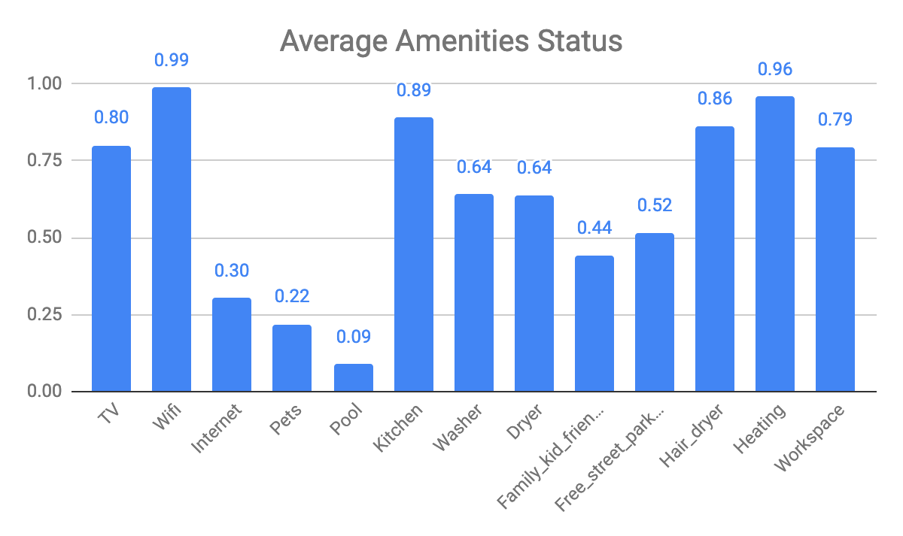
Summary Statistics
Kitchen, Heating and Wifi are almost (~90%) guaranteed to be offered in a property.
Pets Allowance, Pool, Kid Friendly, and Free Street Parking are much more less likely to be offered (~50%)

Slide 10
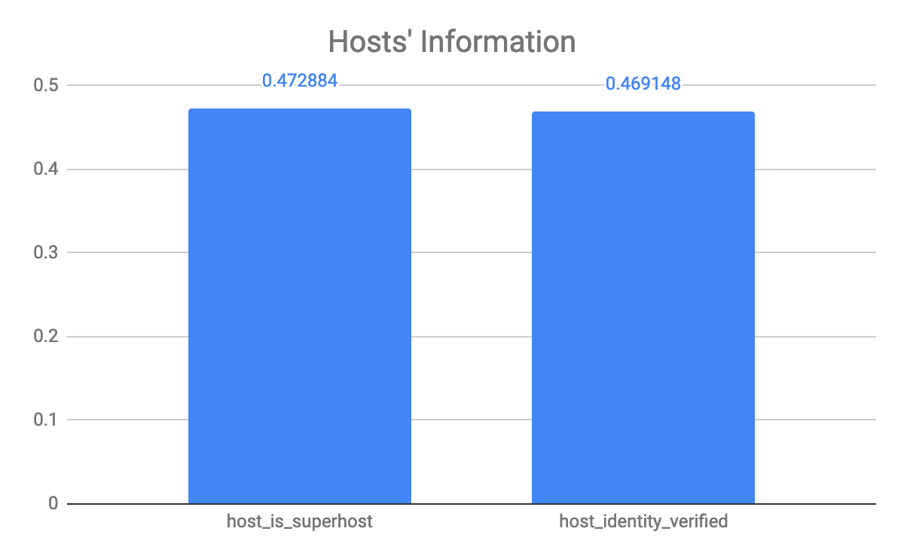
Hosts’ Information
47.29% of hosts are superhost
46.91% of hosts’ identity have been verified

Slide 11
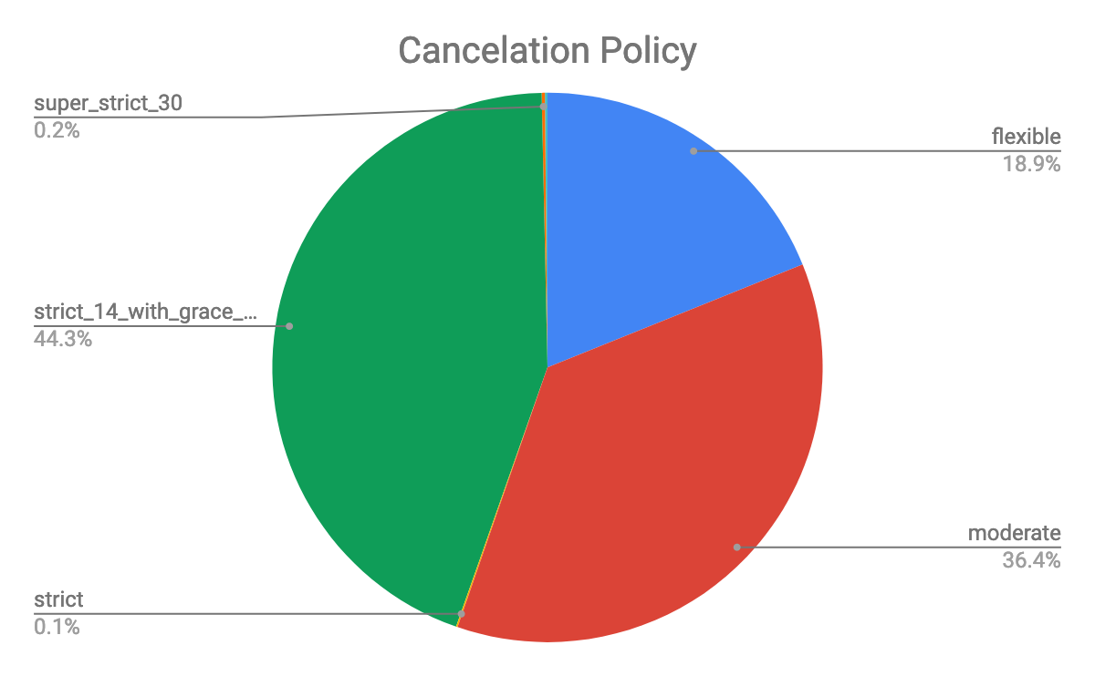
Cancelation Policy

Slide 12
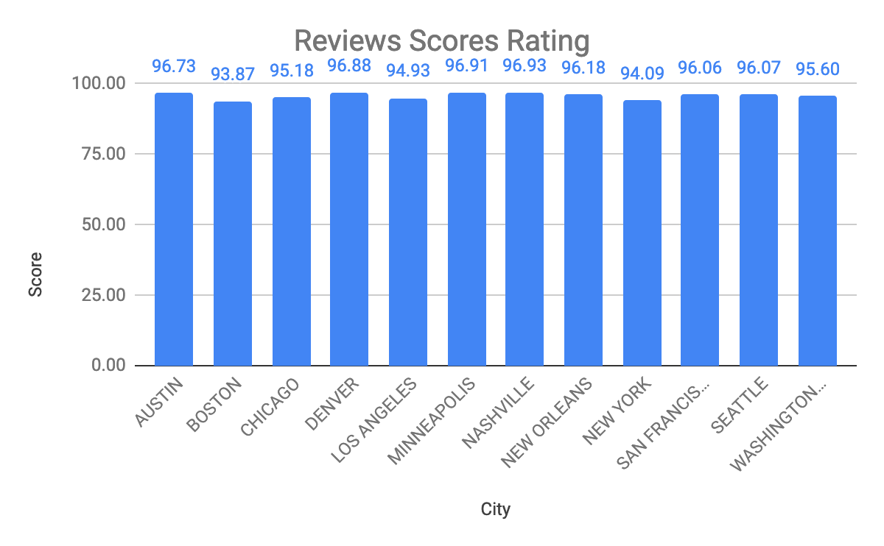
Review Ratings

Slide 13
Modeling & Analysis
OLS Regression
Machine Learning
LASSO
Random Forest
KNN

Slide 14
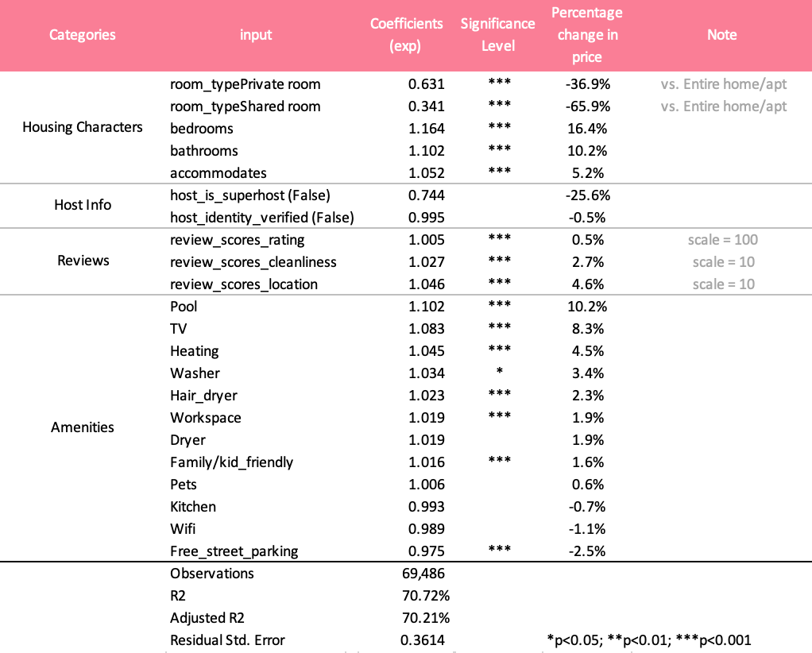
Pricing Factors (OLS regression)
Specification:
log(price) ~ beta*x variables | zip_code | 0 | zip_code
1
Fixed
effect
Cluster
SE
2
3
4
5
Variable Exclusion:
Cancelation Policy
Number of Reviews/ Review per Month
,,,

Slide 15
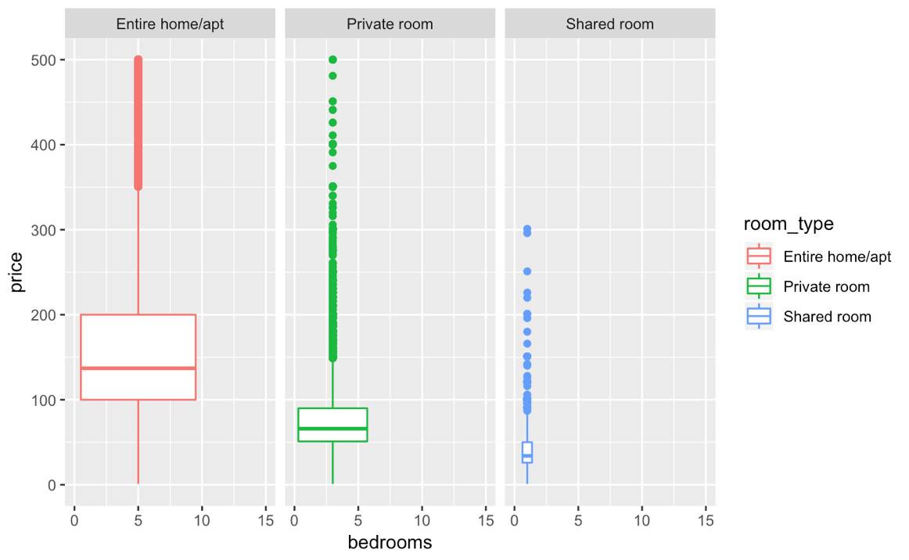
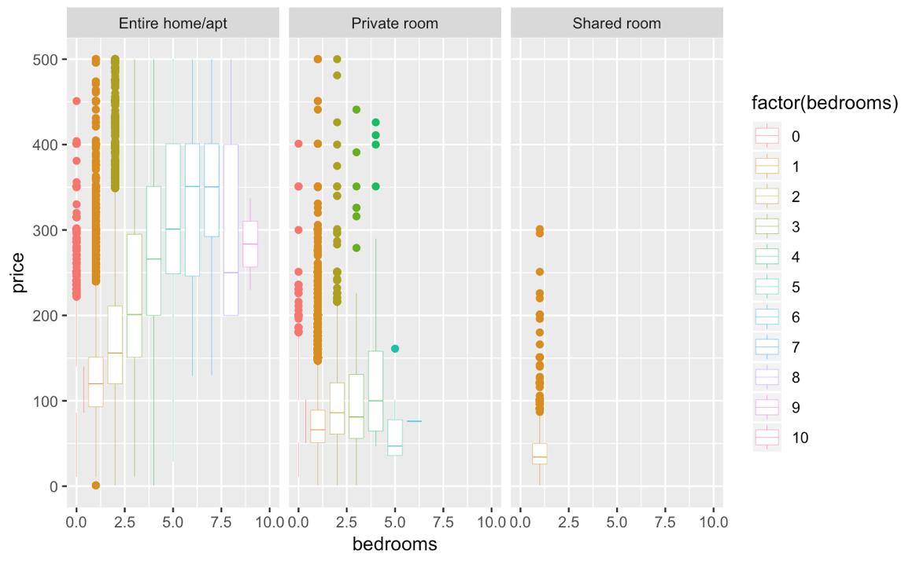
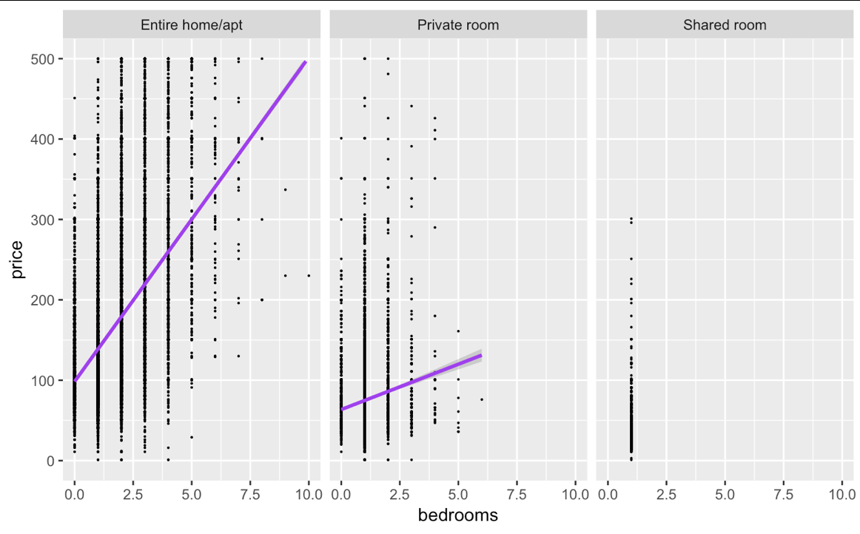
1. Housing Characters
Room Type
Entire Home/ Apt
Private Room
Shared Room
Number of Bedrooms

Slide 16
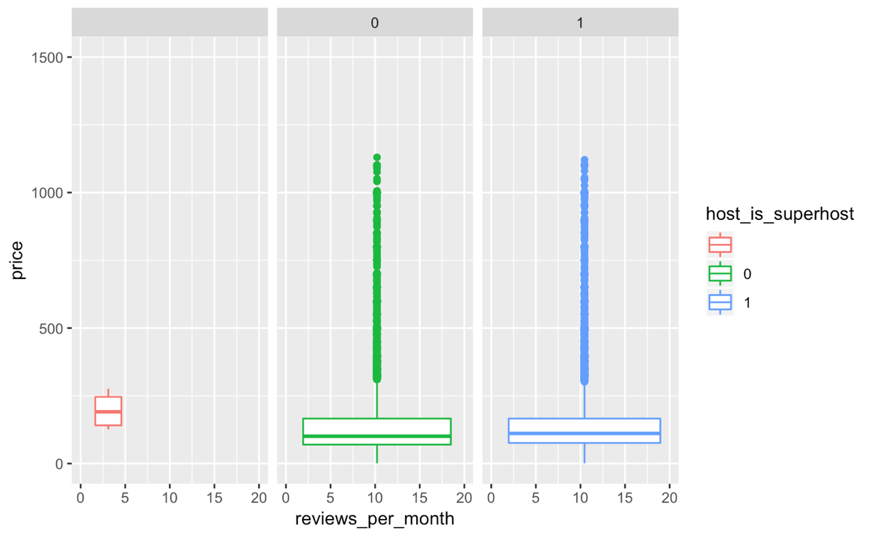
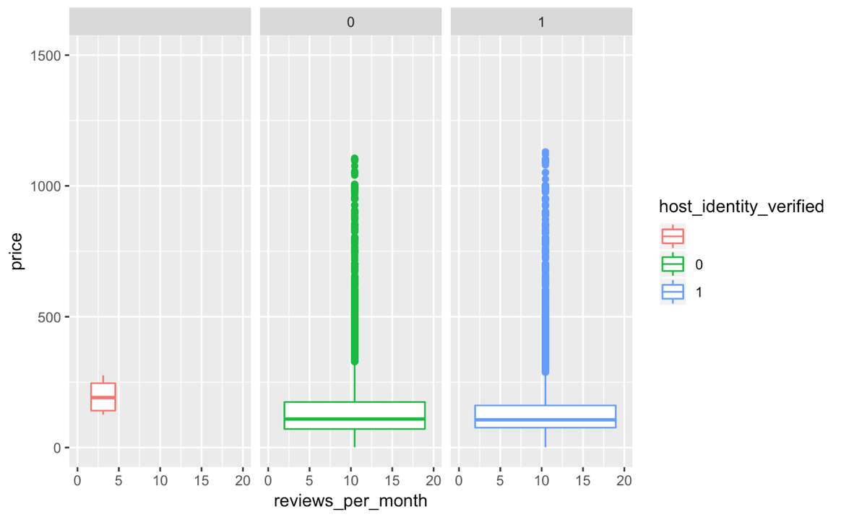
2. Host Info - Super host & Identity verified
Super Host
Identity Verified
null
N
Y
null
N
Y

Slide 17
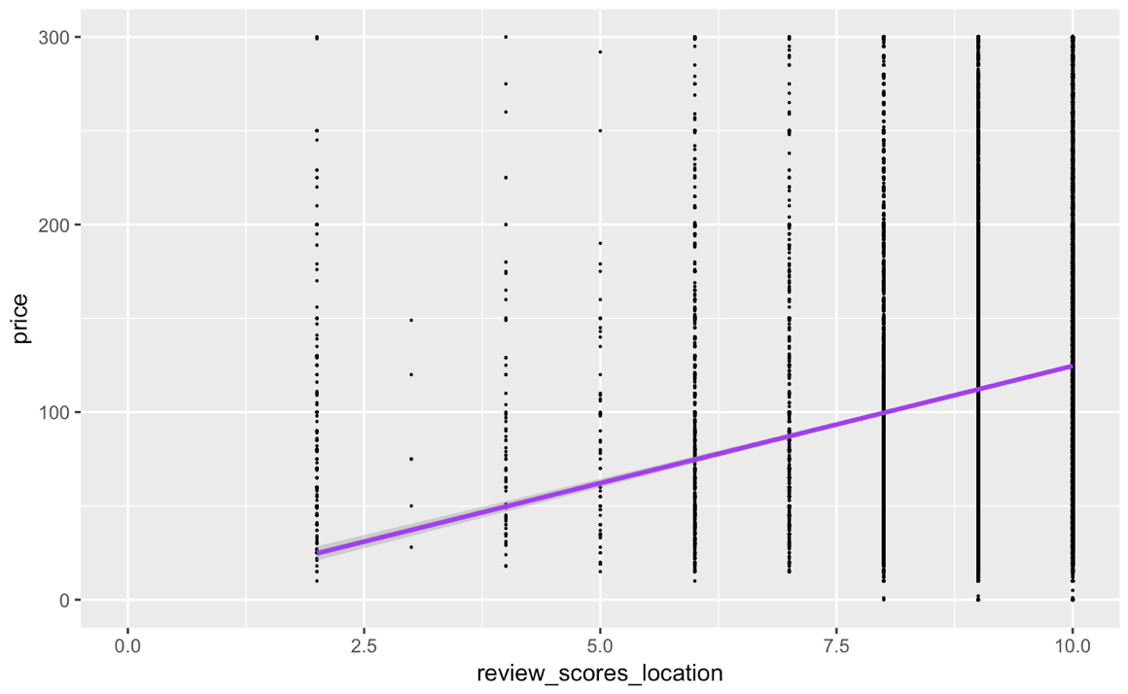
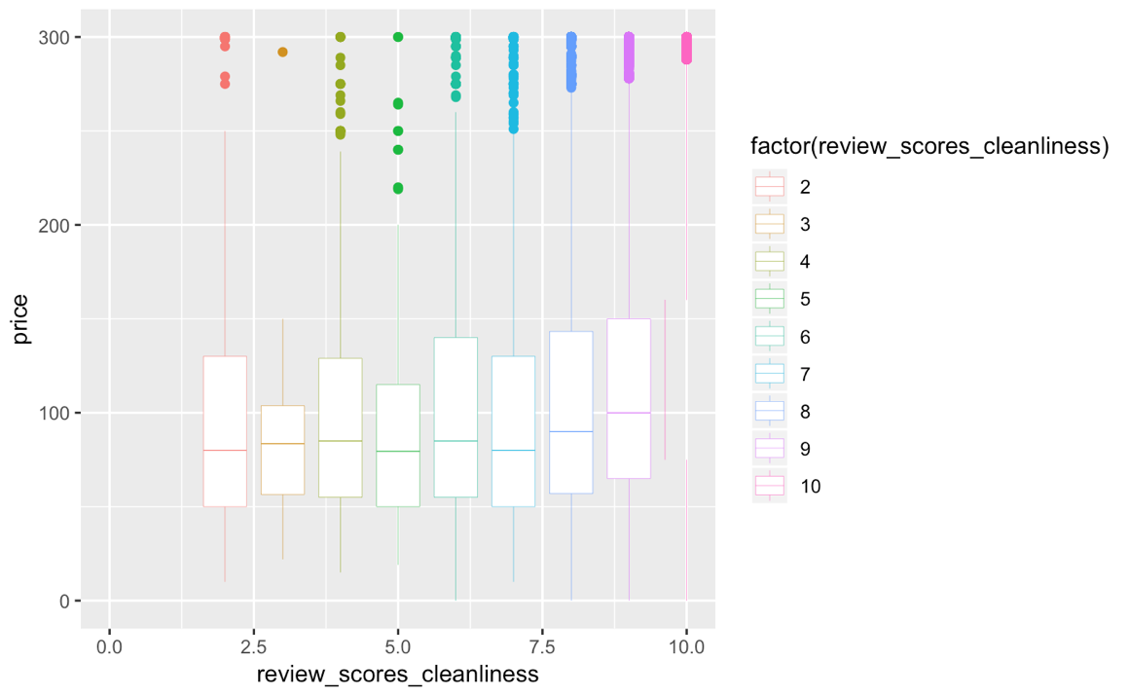
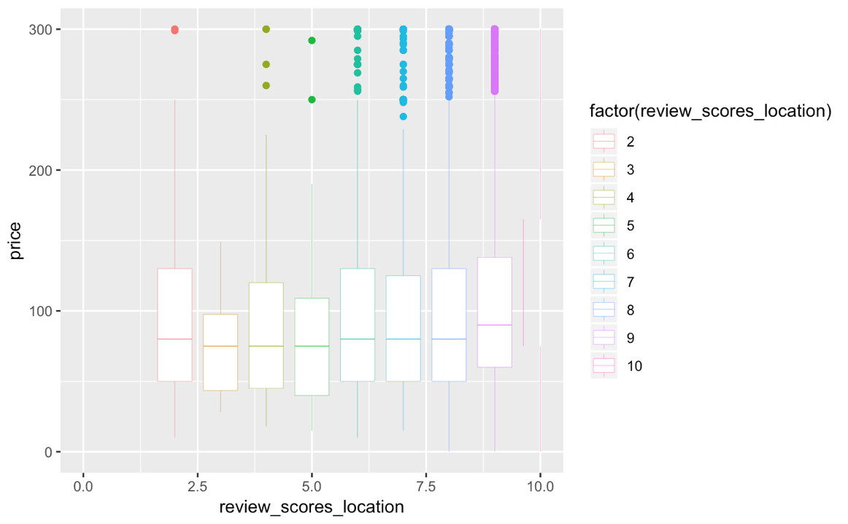
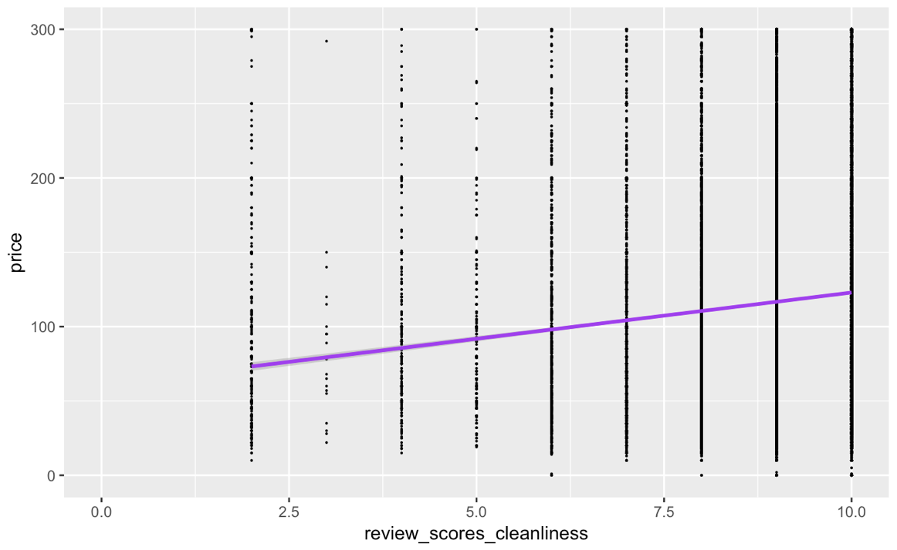
3. Reviews - Location & Cleanliness
Scoring - Location
Scoring - Cleanliness

Slide 18
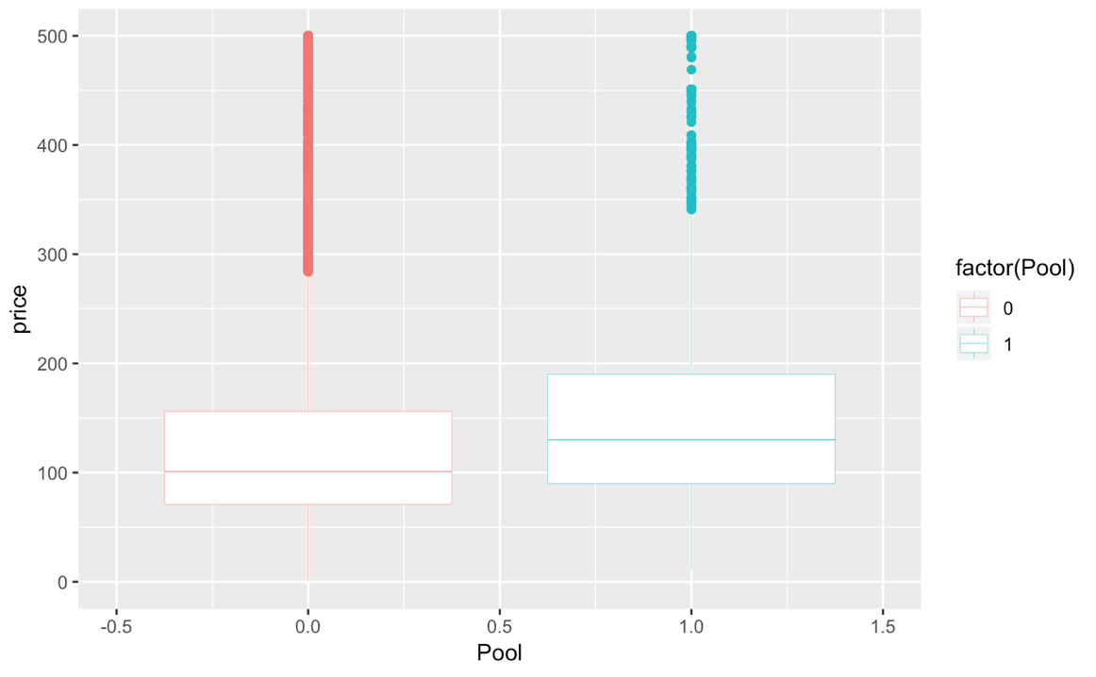
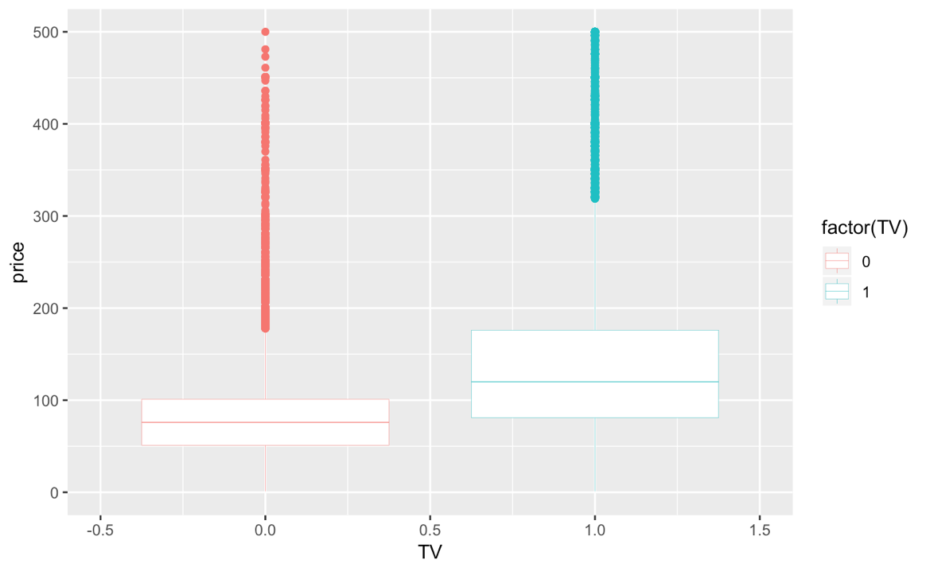
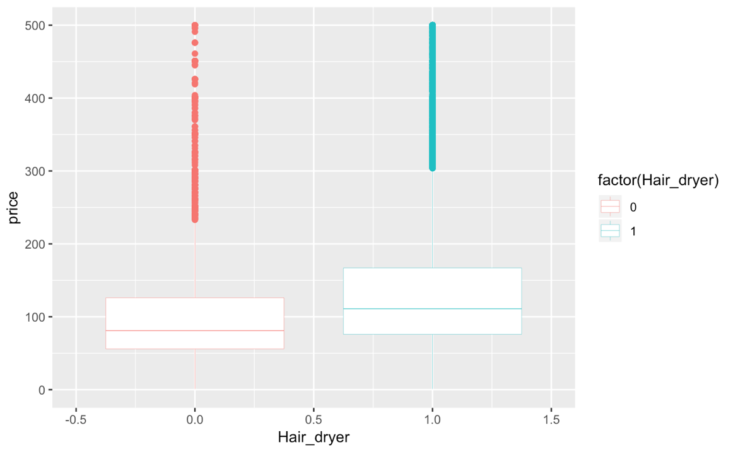
4. Amenities
Pool
TV
Hair Dryer
N
Y
N
Y
N
Y

Slide 19
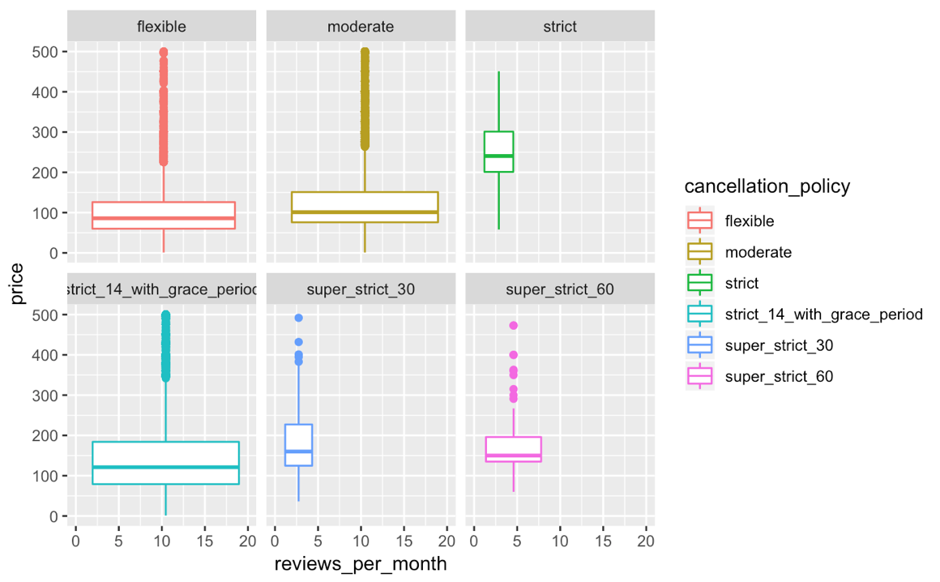
5. Variable Exclusion
Cancelation Policy
Number of Reviews/ Review per Month

Slide 20
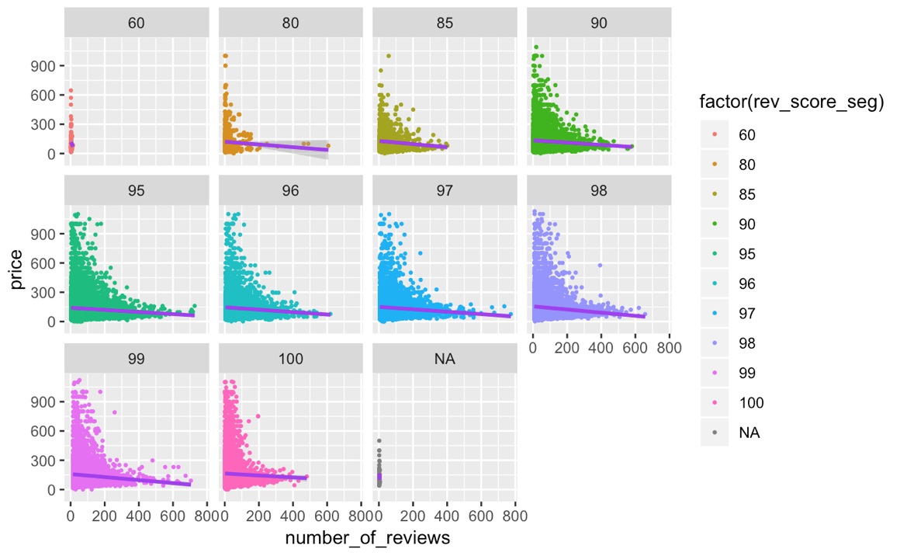
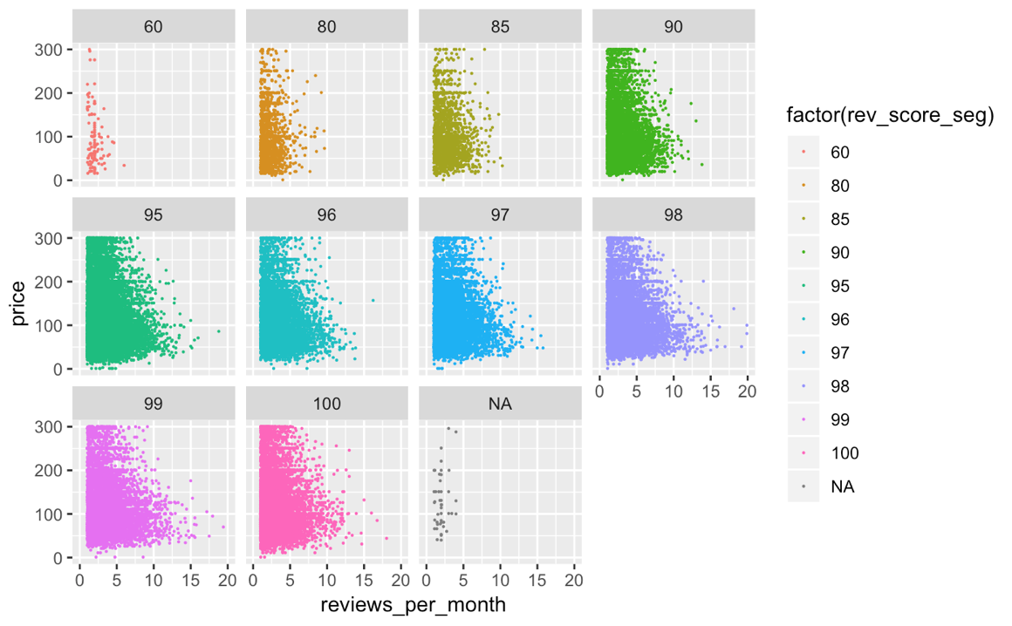
5. Variable Exclusion
Cancelation policy
Number of Reviews / Review per Month

Slide 21
Pricing Factors (OLS regression)
Specification:
log(price) ~ beta*x variables | zip_code | 0 | zip_code
Housing characters plays the determinant roles on price.
Host Info are not significant.
Location & Cleanliness are important.
Travelers are willing to pay more for certain amenities (eg. pool, TV, hair dryer, etc.) ; some amenities might be taken for granted ( eg. wifi, kitchen)

Slide 22
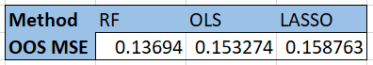
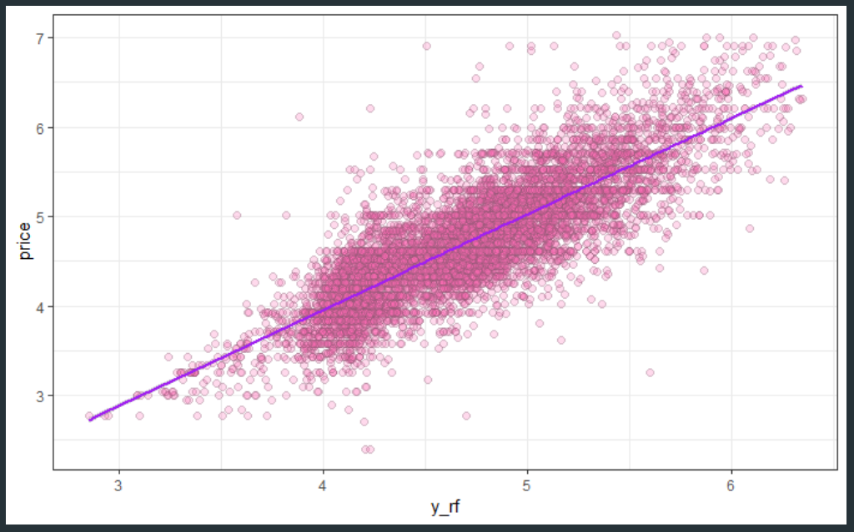
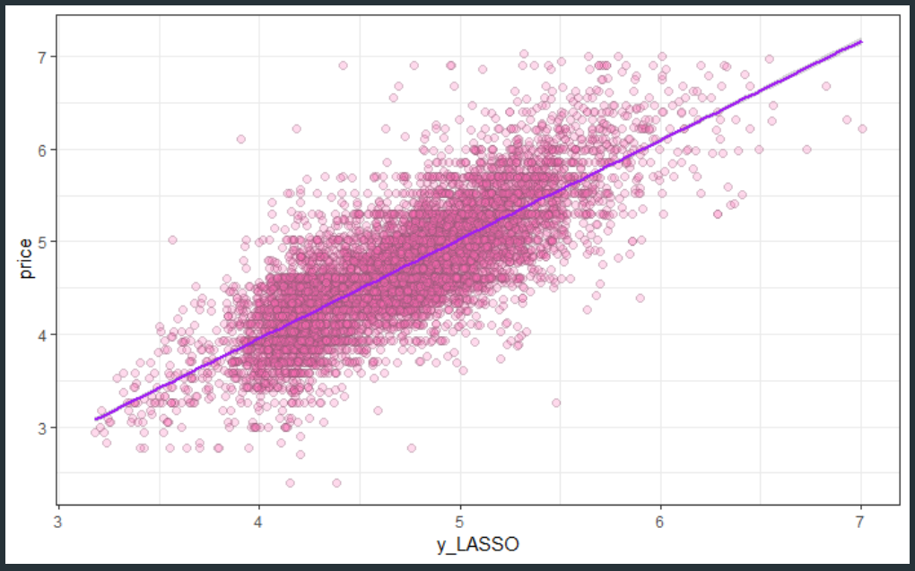
Machine Learning Results

Slide 23
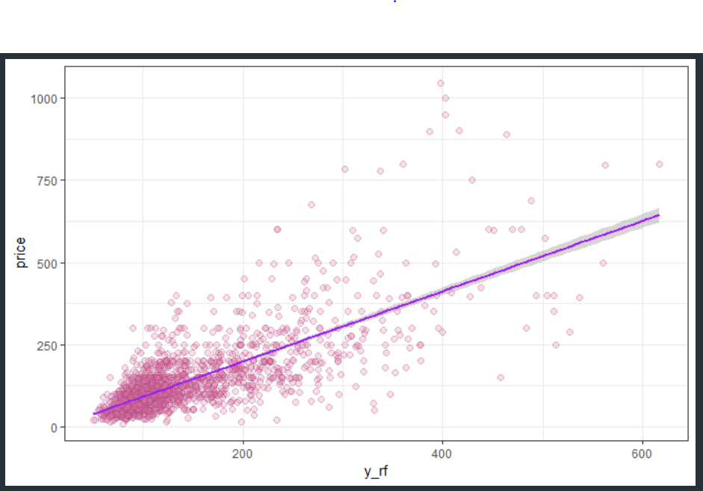
Log vs. Not Log Price

Slide 24
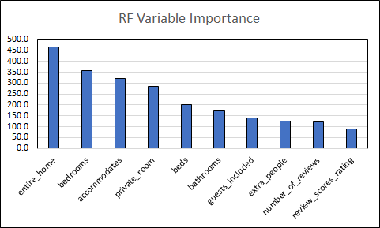
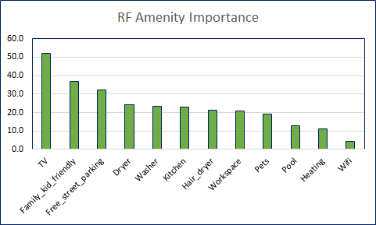
Random Forest

Slide 25
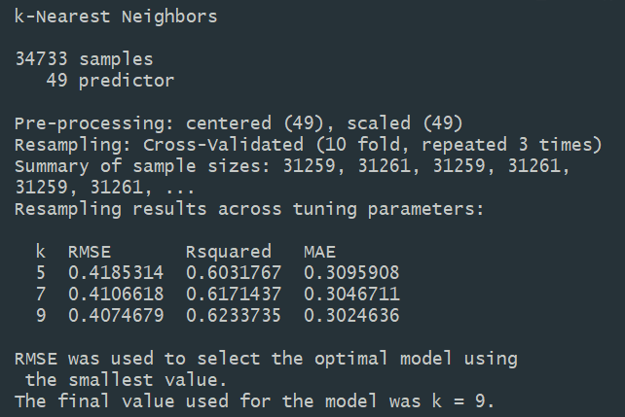
K-Nearest Neighbors
For continuous dependent variable: predicts an average value of the nearest K-observations
Optimal K = 9
RMSE of 0.4075 = MSE of 0.166
Downside: no model output, computationally expensive

Slide 26
Compare ML Lasso to OLS Model
Manually Specified OLS | LASSO Model
Property
bedrooms | bedrooms | value score (-)
bathrooms | bathrooms | checkin score (-)
accommodates | accommodates | communication score (-)
overall review score | overall review score
cleanliness score | cleanliness score
location score | location score
private/shared room (-) | entire home / private room | shared room (-)
 | verified host identity
 | extra people
 | guests included
 | check-in score
 | BOS/SF/NYC | MINN/DEN/CHI/AUS (-)
Manually Specified OLS | LASSO Model
Property cont'd
 | communication score
 | value score
 | superhost
 | number of host listings
Amenity
hair dryer | hair dryer | Free Street Parking (-)
heating | heating
pool | pool
TV | TV
washer | washer
workspace | workspace
family/kid friendly | family/kid friendly
Notes:
Overall, the pink area indicates the cheerful overlap between our theoretical linear model and LASSO model. Both agree that a higher listed price is associated with the increase on number of bedrooms, bathrooms, accommodates and a higher review score, cleanliness score, location score of the property, as well as having hair dryer, heating, pool, TV, washer, working space, and family/kid friendly in amenity.
There are two rows I want to point out.
The room type variable is a factor variable in the specified model. Price is relatively negatively associated with private room and shared room comparing to renting out an entire home. LASSO model provides a similar result such that shared room is associated with lower listing price and customers favor renting an entire house or private room.
We also highlight the city row, because in the specified model, we used zipcode as our fixed effect due to the obvious difference presented in our descriptive analysis section. In the LASSO model, a higher price is associated with Boston, San Francisco, and New York City and negatively associated with Minneapolis, Denver, Chicago, and Austin.

Slide 27
Conclusion
Business Recommendation
Limitation & Future Direction

Slide 28
Recommendation
Actionable
Increase the accommodation ability, i.e. bunk beds, sofa beds, etc. (>5%).
Make sure the house is clean (2.3%).
Offer hair dryer, heating, TV, washer, and workspace (i.e. a nice desk) and open to families and kids (1.5% ~ 8%) per item.
Renting out the entire house.
Overall
A better location (4.6%).
For every one more bedroom (16.4%) and bathrooms (10%).
Having a pool (10%).
Notes:
Overall
Better location is captured by location review score by zip code
Ok
If you have a pool, mention it.
Actionable
ok
Cuz for every increase in cleanliness review score, the price can be increase by 2.3%
Will attract customers who are willing to pay (1.5 ~ 8%) per item, comparing with the house that has none of those
Generally, renting out the entire house will fetch a higher price comparing to renting out a private bedroom or a bed in a shared room.

Slide 29
Limitations & Future Direction
Limitation
Limited skills on text mining and image processing.
Model may not accurately predict high priced listings.
OLS is not a causal model.
Future Direction
Texting mining and text analysis on verbal listing & review descriptions.
Image processing on property photos listed on Airbnb app.
Notes:
Our lack of skills on text mining and image processing only allows us to
Due to our method on abandoning the outliers in listing (low booked and extremely expensive properties). Therefore, our estimated accurate prediction range is within $200
We can only talk about association, but not give a precise function on how each variable would contribute to the price

Slide 30
Q&A

Slide 32
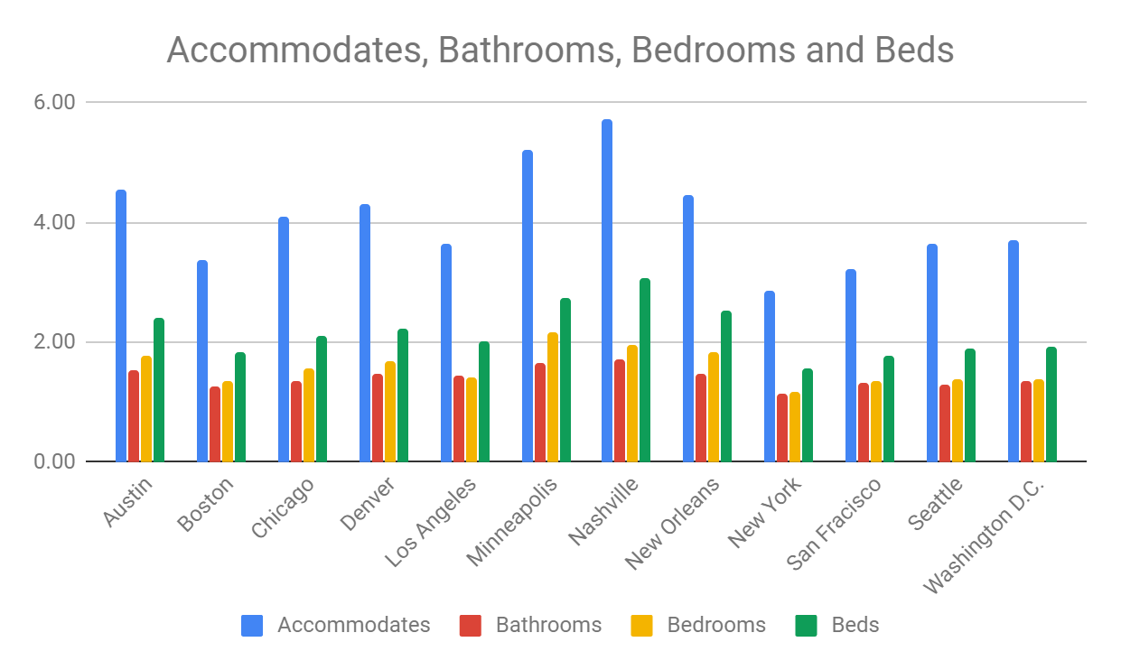
Appendix 1

Slide 33
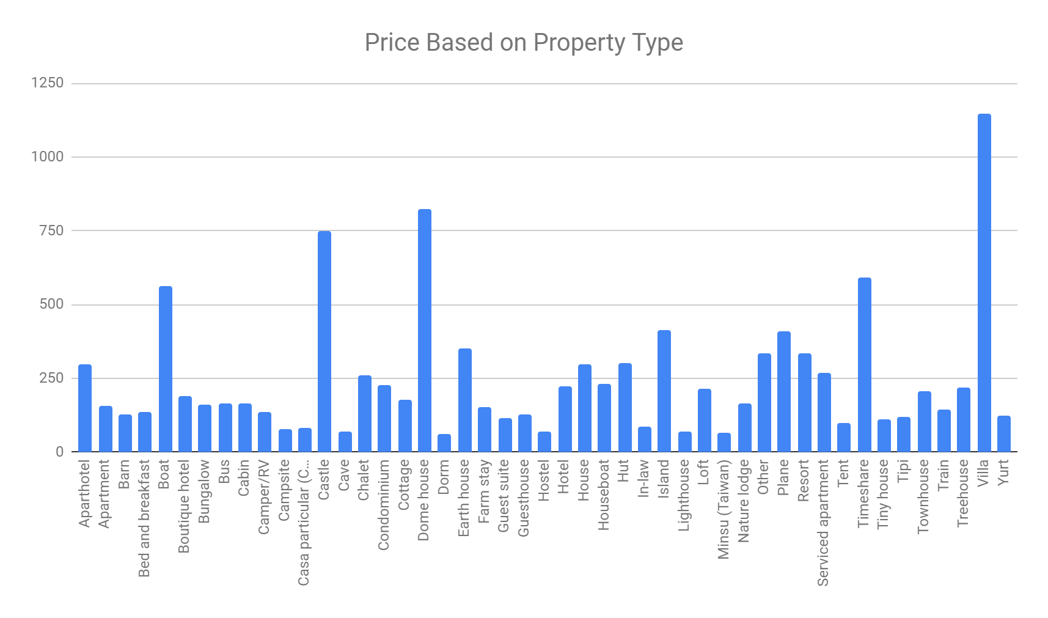
Appendix 2

Slide 34
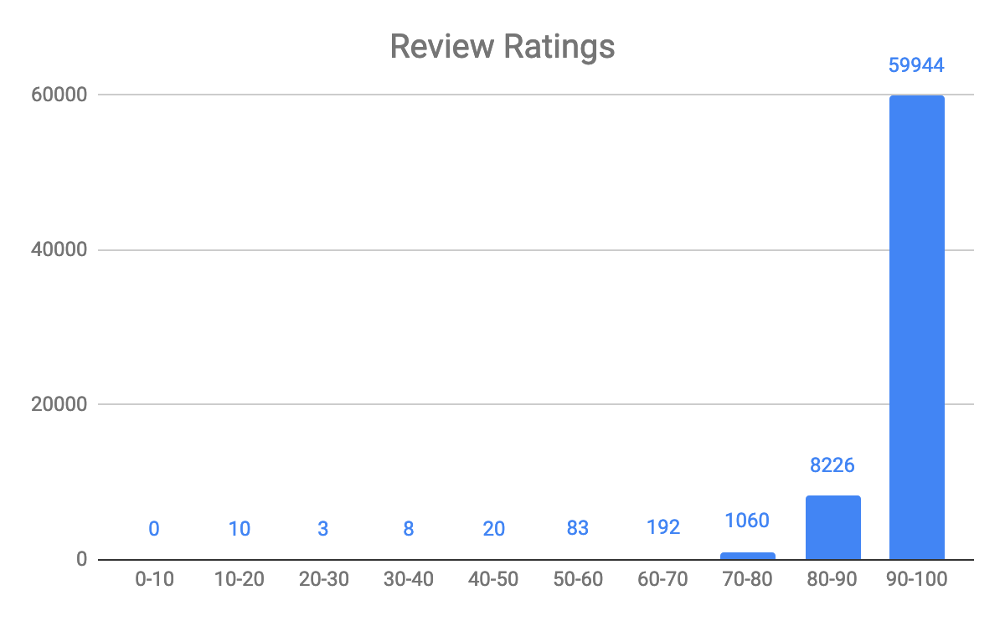
Review Ratings
Most Airbnb customer are satisfied, scores are inflated

Slide 35
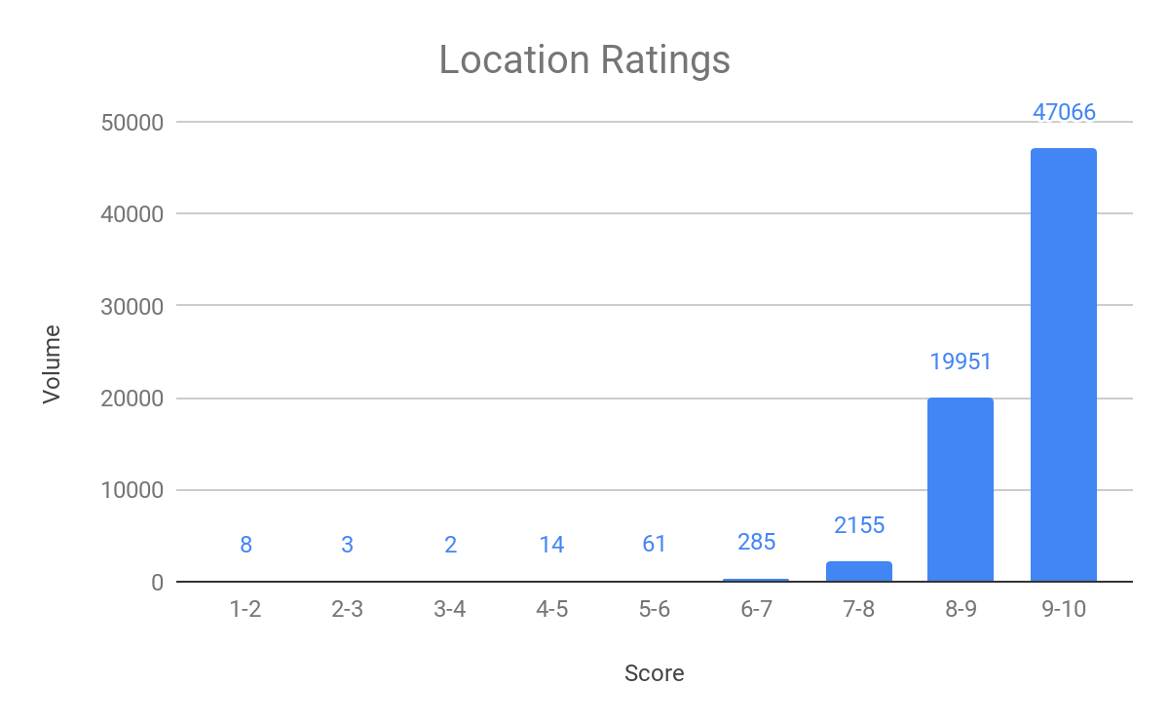
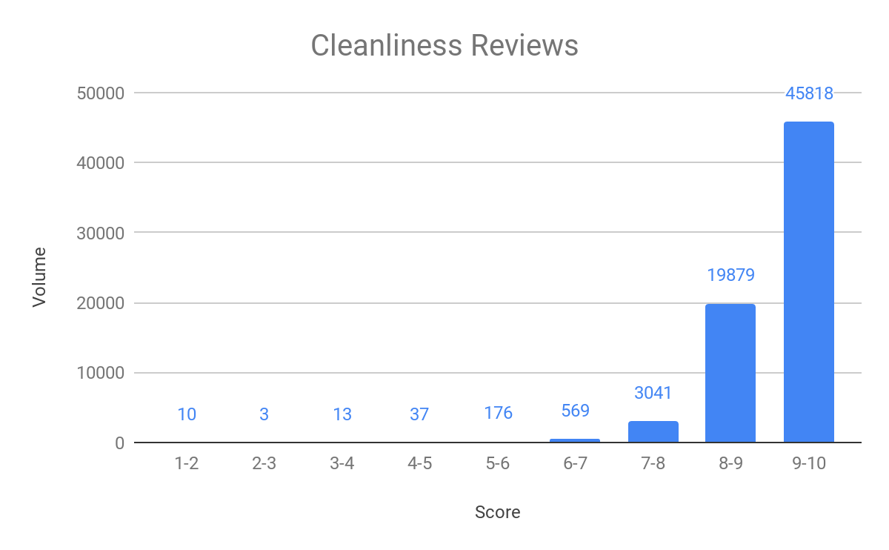
Location & Cleanliness Score

Slide 36
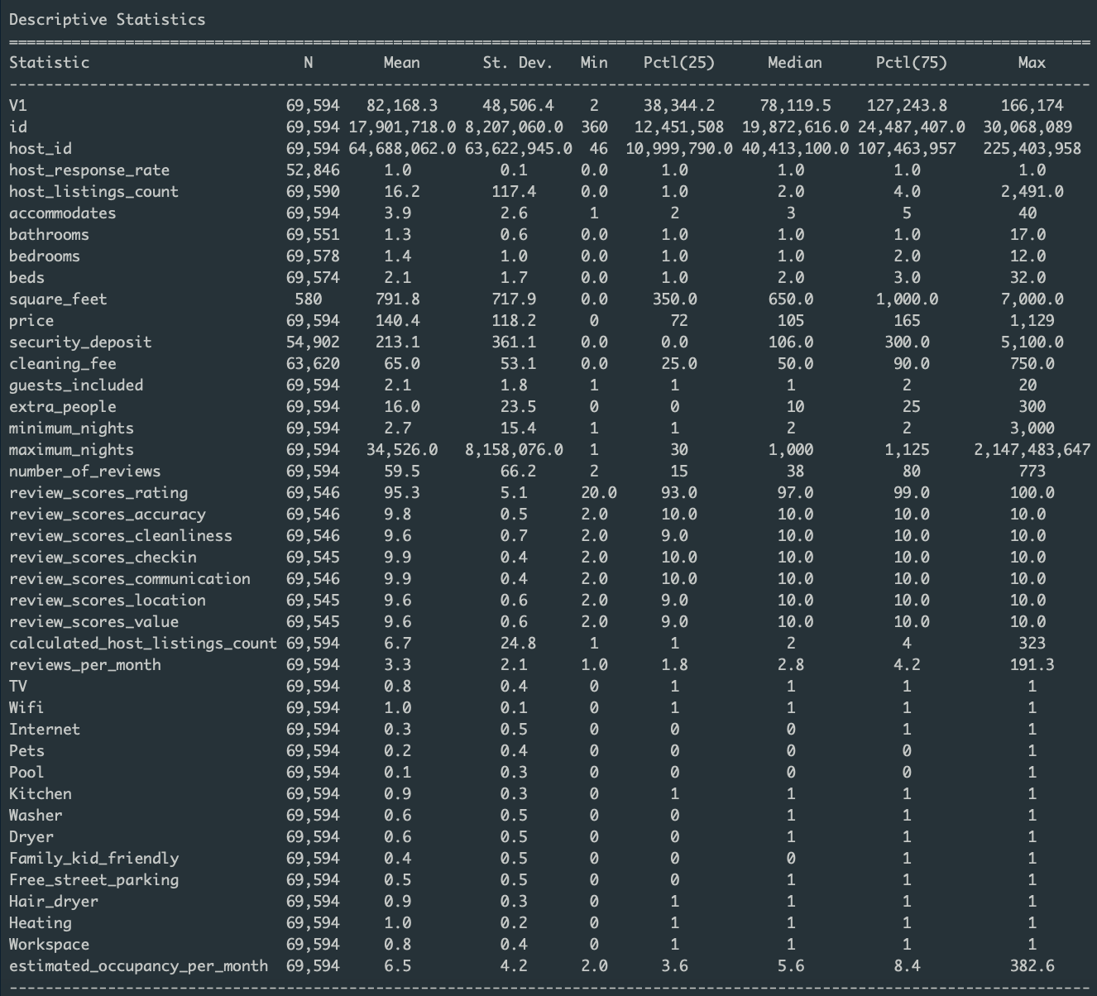
Appendix 3
Cleaned Data
Most variables have enough data, except for square feet
Created dummies for the amenities

Slide 37
Suggested Presentation Outline
1. Objective statement
(a) What are the insights you hope to obtain? (b) What are the challenges in achieving those objectives?
2. Data Description
(a) Where did the data come from? From whom? (b) How were they generated?(c) How are they structured?(d) Overview of what you did with them to prepare for analysis
3. Summary statistics
(a) Give a summary of the data that helps us understand them
4. Analysis
(a) How did you overcome the difficulties in achieving the objective? (b) What assumptions did you have to make?(c) What do you find?
5. Conclusions (a) What should managers take away from this analysis?(b) What are the main concerns when interpreting your analysis? (Describe how the assumptions in your analysis might be violated in a way that non- technical people can understand them.)

Slide 38
Business Importance
Airbnb charges travelers a 6 -12 percent service fee depending on duration of trip
Also charges hosts a flat 3 percent fee for each booking
Incentive to maximize number of bookings and trip price
Credit: https://bmtoolbox.net/stories/airbnb/

Slide 39
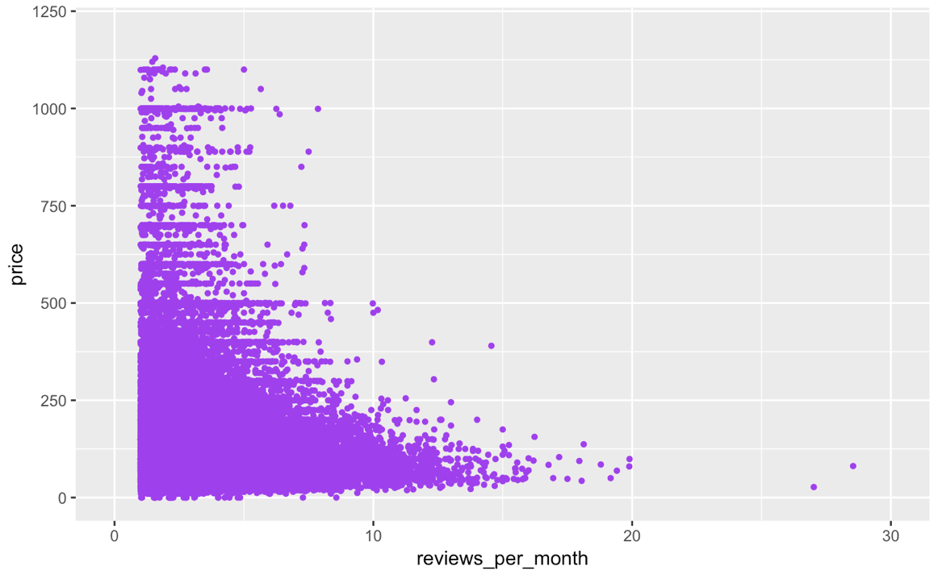
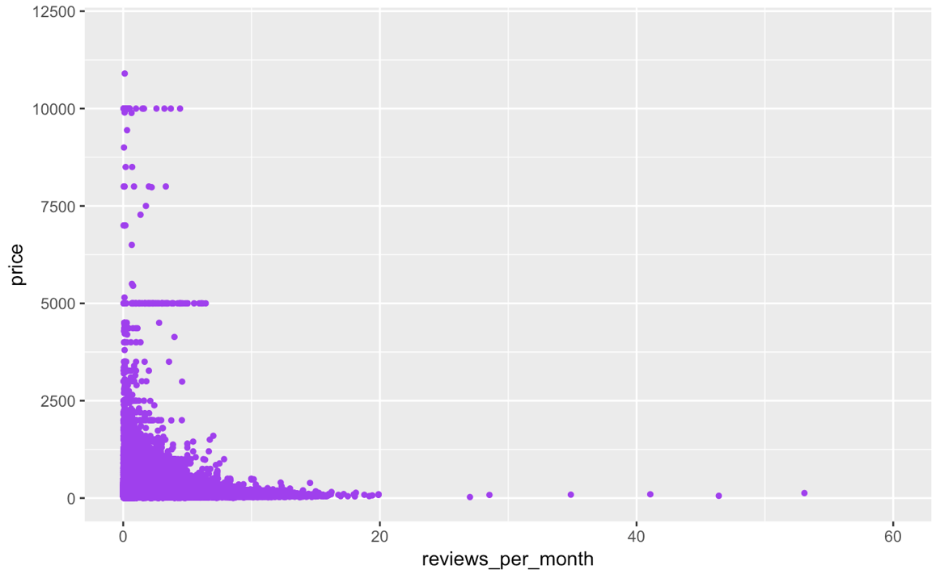

Slide 40
Go work on your own part!
Stop peeping me Jared :-p. Lol nice work tho!
Entire Home/ Apt
Private Room
Shared Room

Slide 41
Stop peeping me Jared :-p

Slide 42
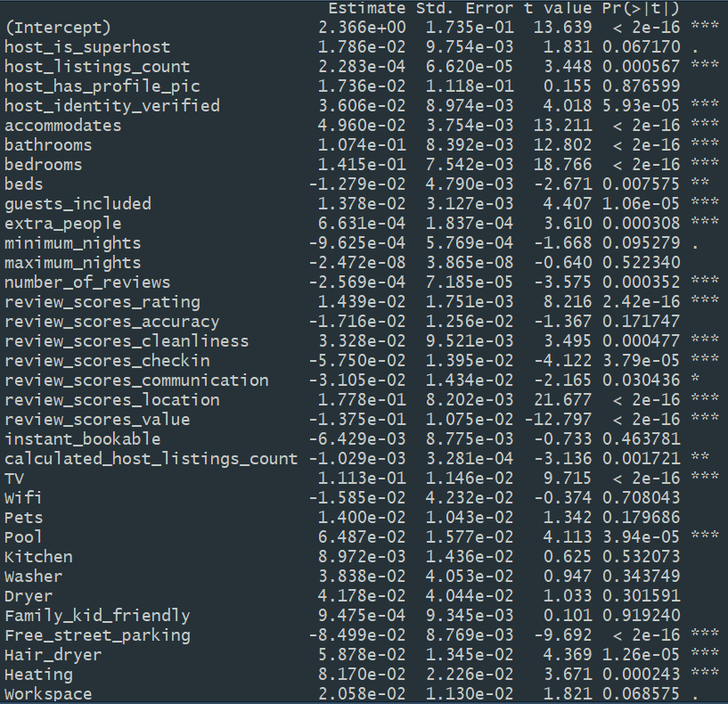
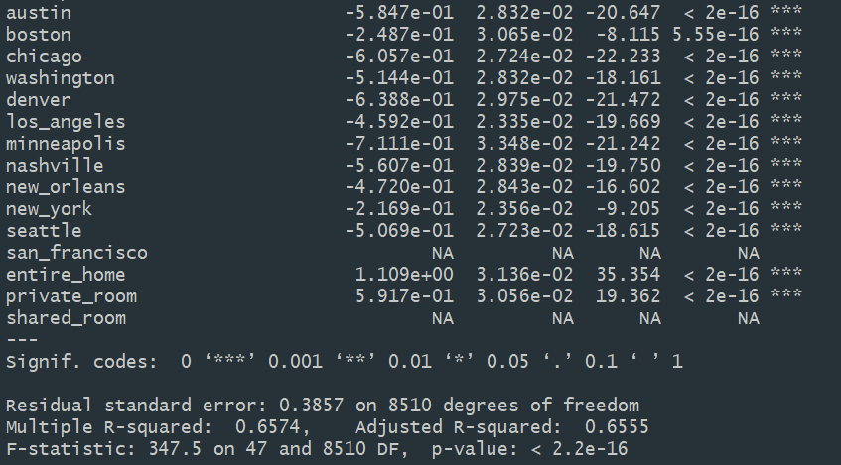
OLS Output

Slide 43
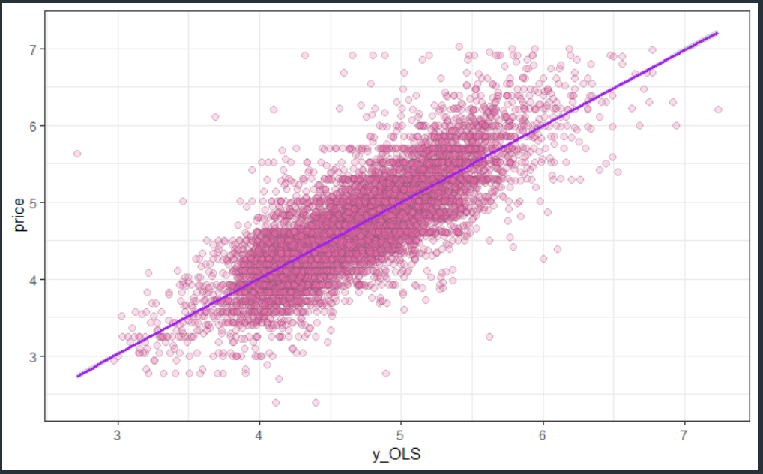
Machine Learning Results

Slide 44
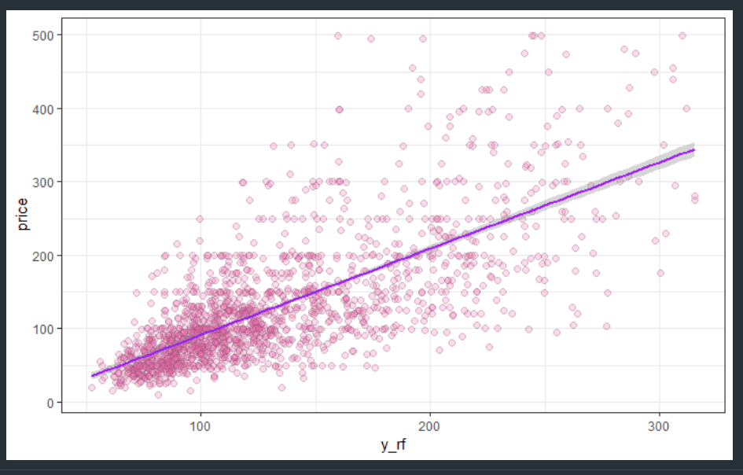
Random Forest Model
Without Subset: MSE = 5164.36
Subset Prices < 500: MSE = 2778.17

Slide 45
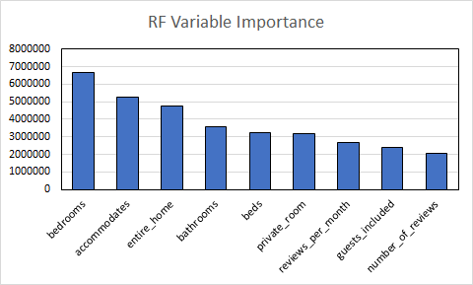
Random Forest

